Slide 1
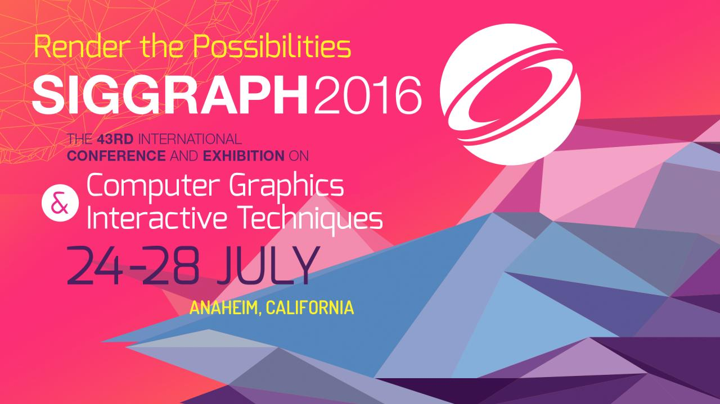

Slide 2
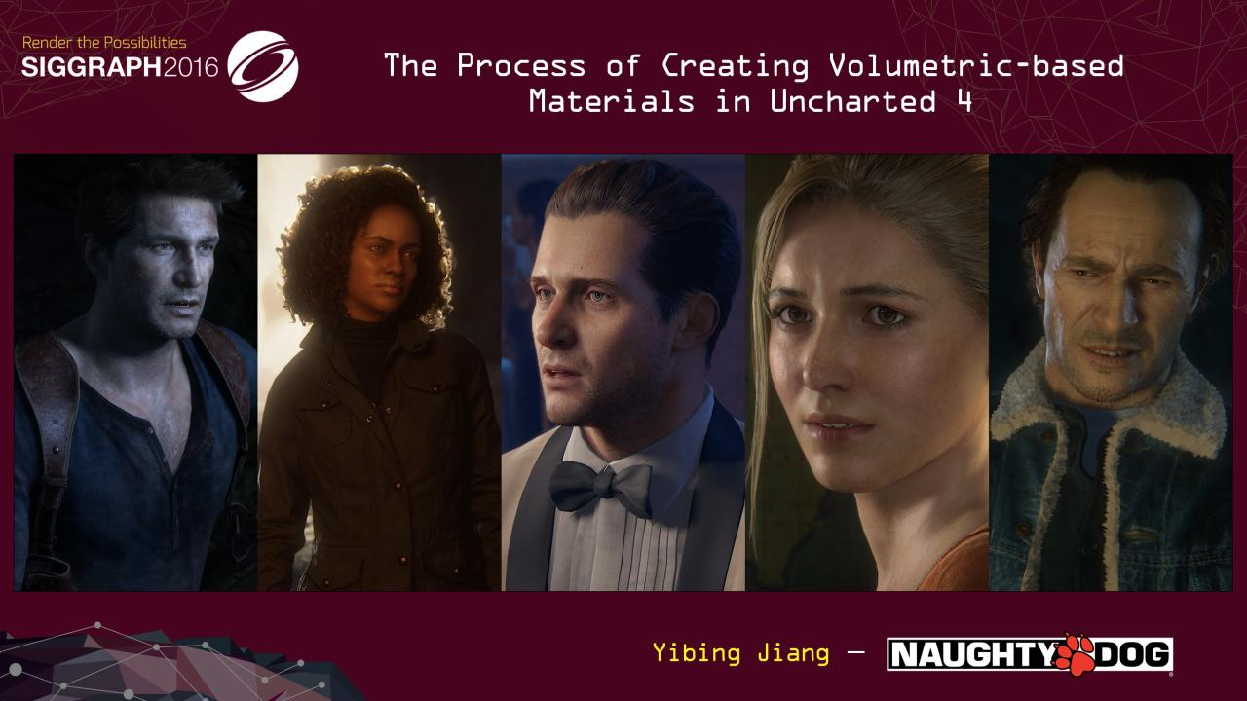
Notes:
Hi everyone, welcome to the course.
My name is Yibing Jiang. I am the Senior Shading Artist of Naughty Dog. My responsibility includes in charge of all the character materials of Uncharted 4, working with Character Artists to get good final render results in every possible situation.

Slide 3
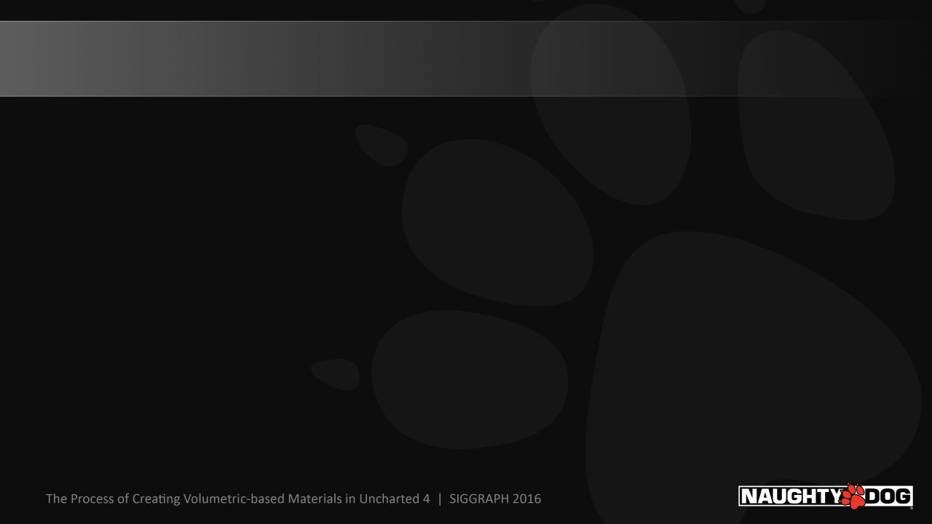
Topics That Will Be Discussed
Early stage of building character shading pipeline
Fabric Shader Library
Hair Shader Library
Introduction of Shader packages and examples
Notes:
Based on the title, you probably already know that instead of generally talking about all the materials that we created for Uncharted 4 characters, I will mainly focus on how we created fabric and hair.
We will also talk about the issues that we are facing in the early stage of building character shading pipeline.
At the last, I will introduce to you shader packages, which been widely used in our character shading pipeline and we will show examples of them.

Slide 4
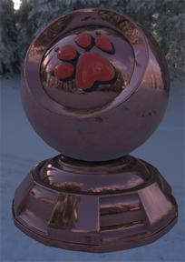
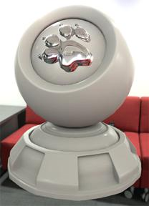
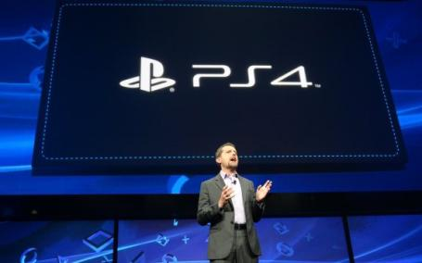
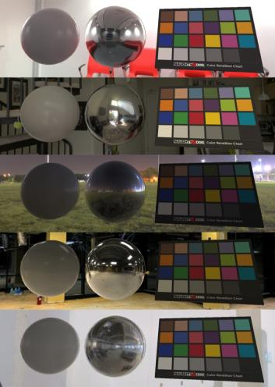

It Was the Best of Times, It Was the Worst of Times
Notes:
I remember we started to develop character shading pipeline at the end of 2012.
At that time we knew PlayStation 4 was on the way. We were so excited about working on the “next-gen” console that allows us to ship a game that probably will look like a movie.

Slide 5
Early Stage of Building the Character Shading Pipeline
We had certain expectations of what next-gen consoles were capable of handling
We treated the PlayStation 4 like a render farm, by using expensive features that are impossible to run real-time in our engine.
High-res texture maps;
Fully alpha blended hair transparency maps;
Multi-Sample Anti-Aliasing;
High-res shadows.
We thought everything would have to be “physically based” from now on. As long as we implemented Disney’s “principled” BRDF in our engine, our game would look like a movie.
Notes:
We had certain expectations of what next-gen consoles were capable of handling

Slide 6
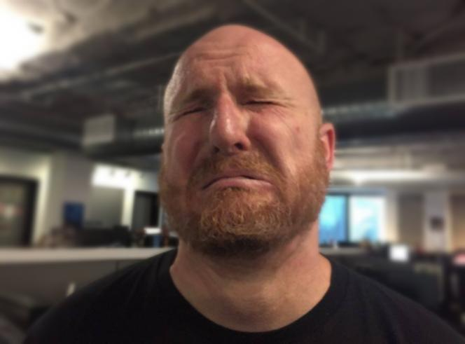
But the Reality Is …
Notes:
We can’t afford most of those expensive features that mentioned above.
Disney BRDF is not enough to cover most of the character materials.

Slide 7
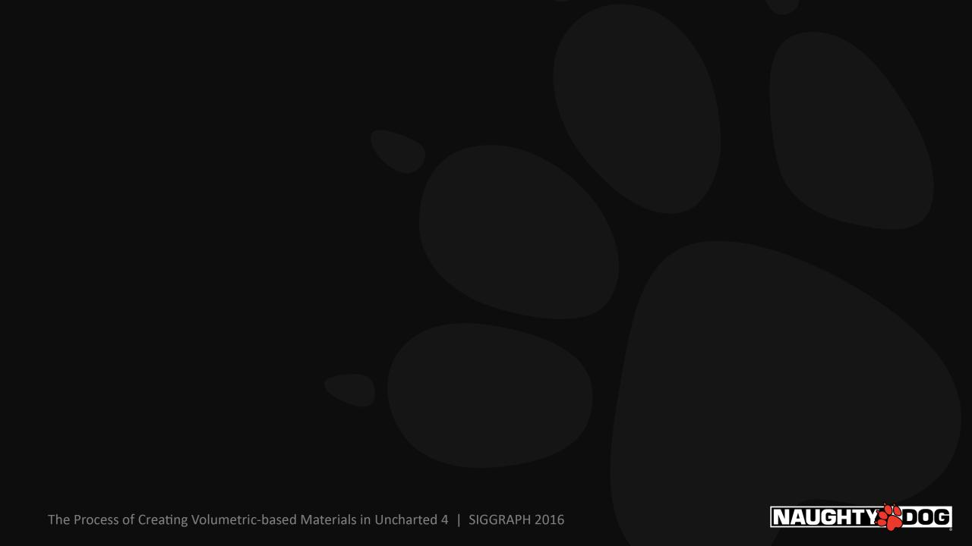
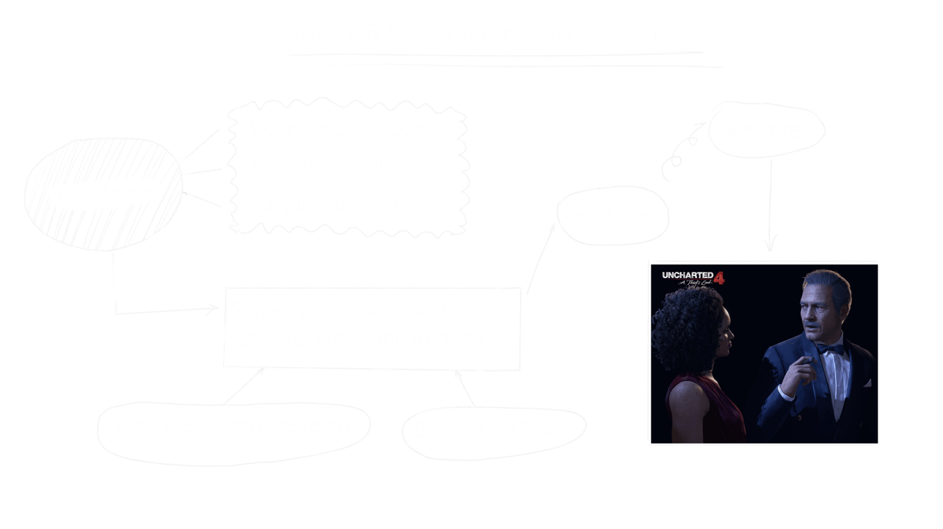
Notes:
Then it got us really think about the what we need for character shading.

Slide 8
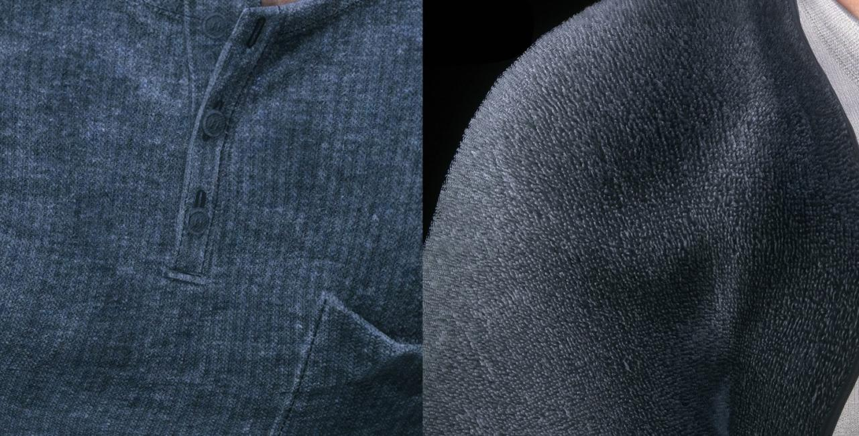
Notes:
Building fabric shader library

Slide 9
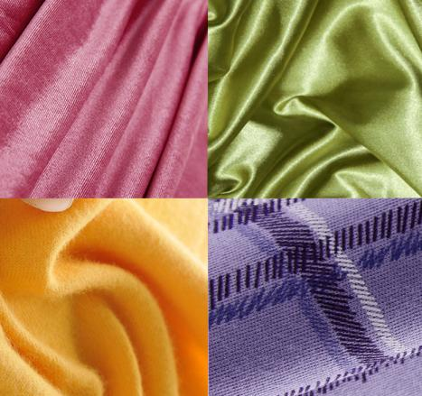
Challenges of Making Fabrics
There are large varieties of fabric types
How to achieve different reflectance models
Fabrics have a high degree of scattering
Tileable micro-weave structures
Volumetric self-shadow
Adding imperfection to the details in order to create a more realistic appearance
Fabric reference images

Slide 10
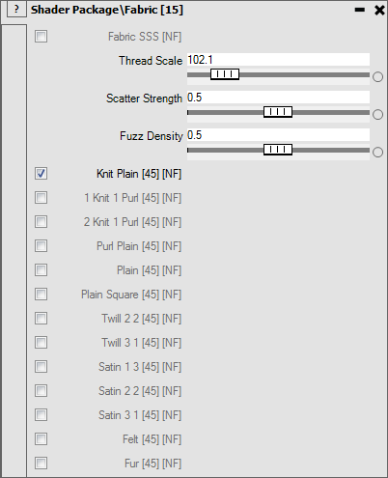
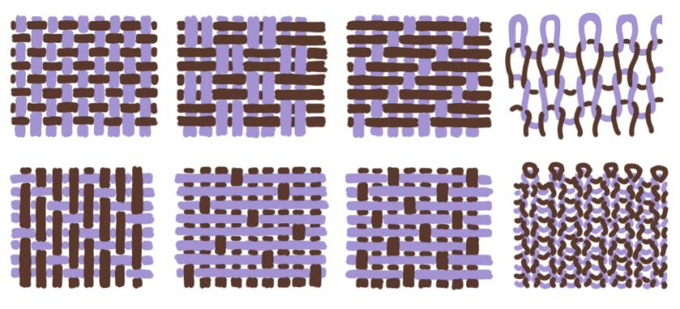
Micro-Weave Structures
We picked a number of weave patterns

Slide 11
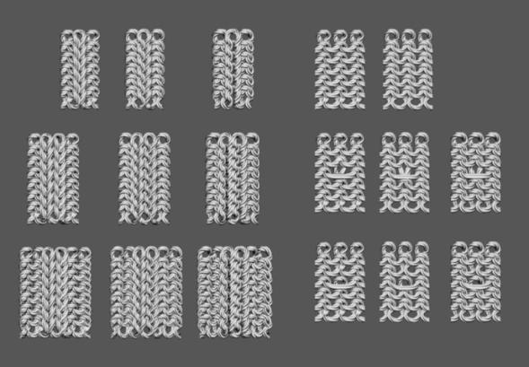
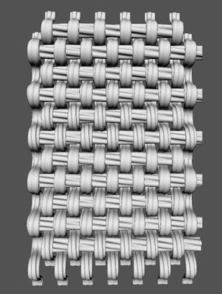
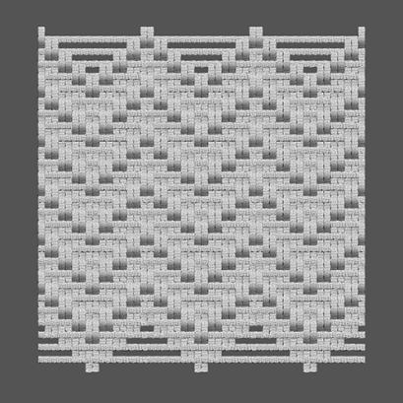
Micro-Weave Structures
2. Modeled the source files in Maya

Slide 12
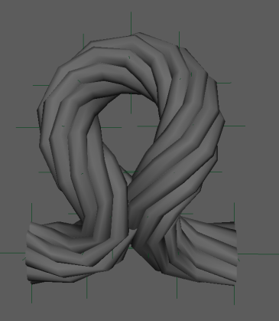
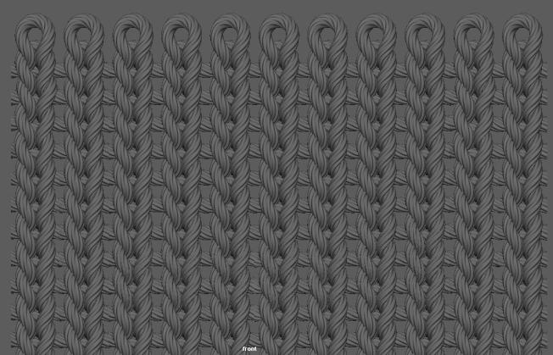
Micro-Weave Structures
Created a simple rig from twisted tubes. Moved the locators to get the shape we wanted.
Duplicated the source mesh, and ran the scripts to merge the edges

Slide 13
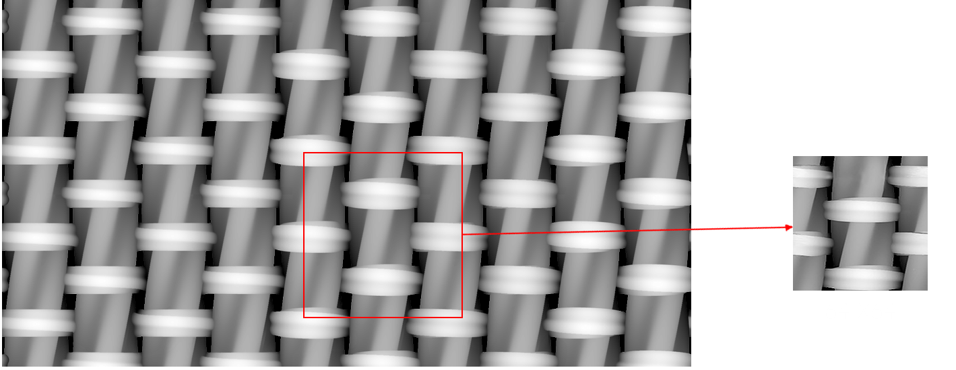
Question: Why Didn’t We Use Scanned Fabrics?
1. Save texture memory

Slide 14
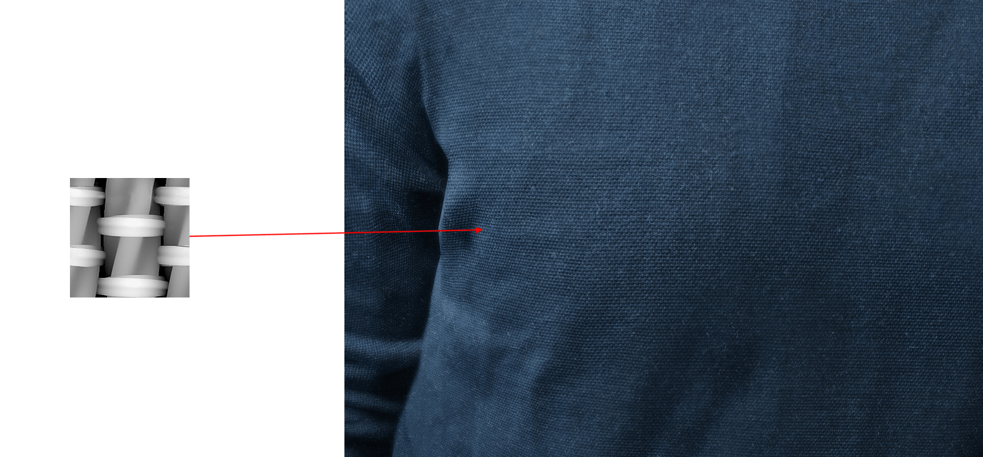
Question: Why Didn’t We Use Scanned Fabrics?
2. Keep all the details without worrying about MIP mapping

Slide 15
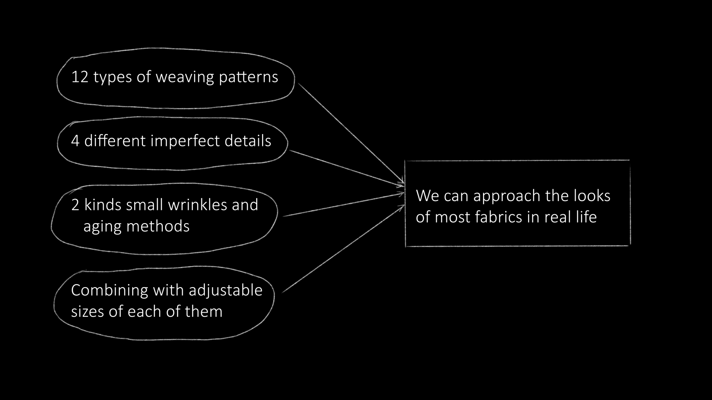
Question: Why Didn’t We Use Scanned Fabrics?
3. Combining different types of micro-detail textures, we can approach the look of most fabrics in real life

Slide 16
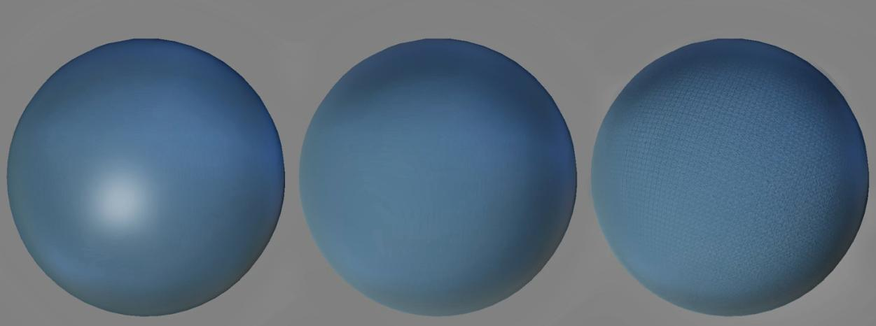
Combing Multiple Resolution Tileable Details
Base color + GGX Changed to fabric BRDF Added fabric weave details

Slide 17
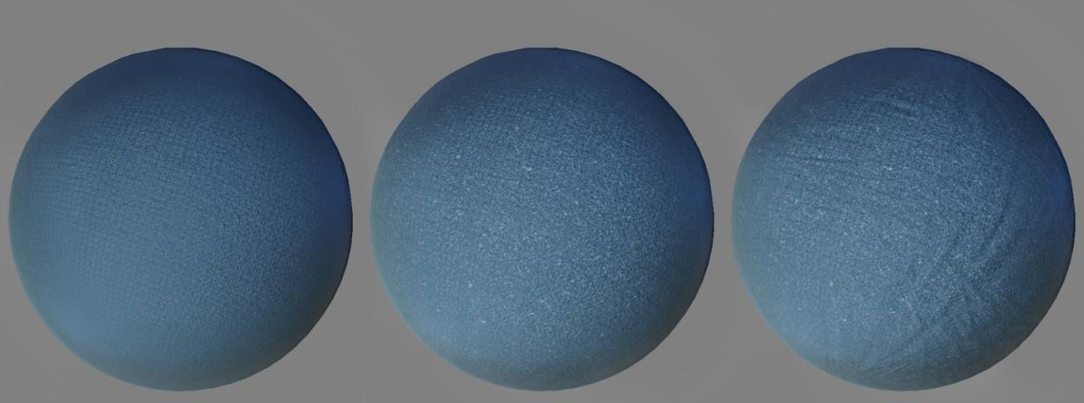
Combing Multiple Resolution Tileable Details
Added fabric aging Added imperfection details Added small wrinkles

Slide 18
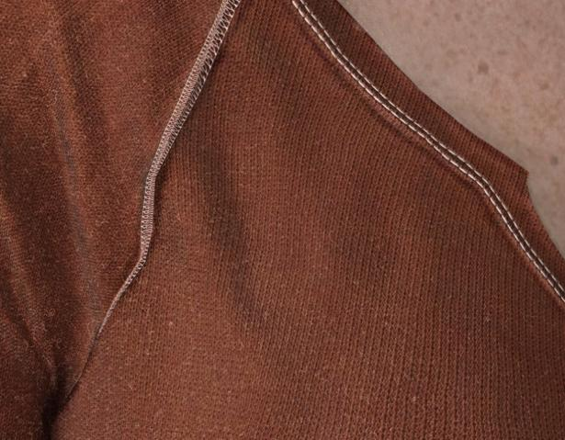
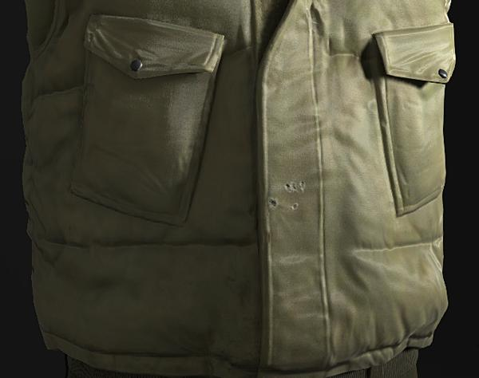
Adding Stitches and Holes
Notes:
We also used UvSet2 for stitches and holes. They were built by using the same idea as fabric weave patterns.

Slide 19
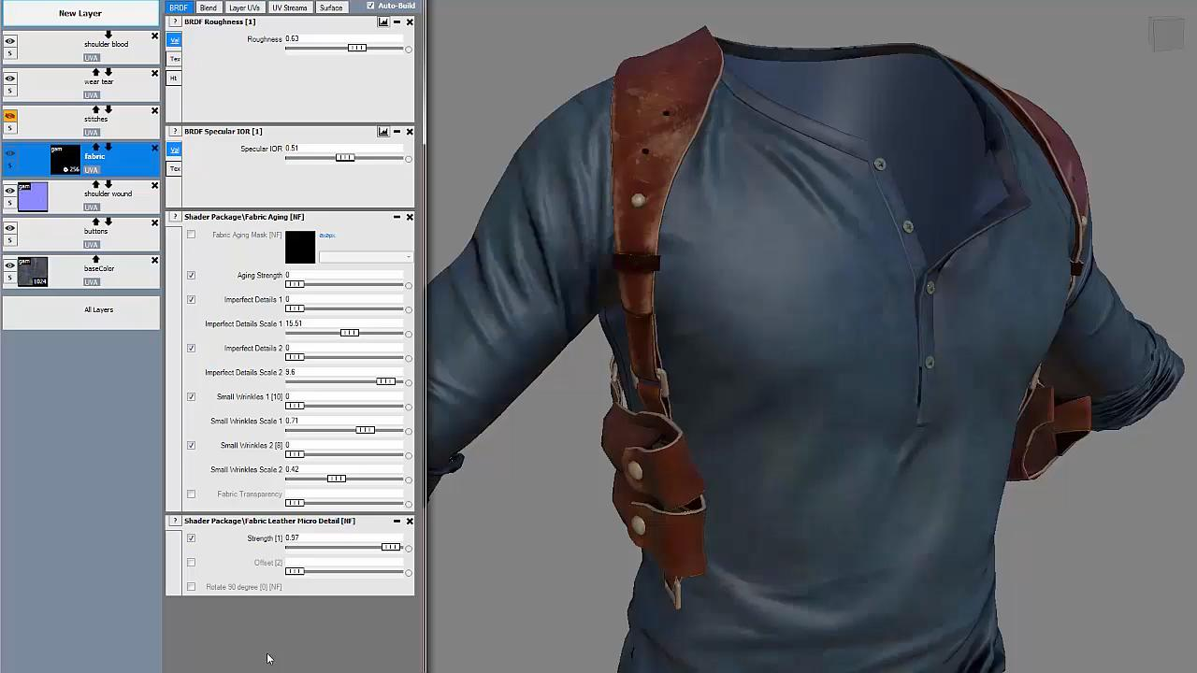
How Did We Implement This In-Game ?
Notes:
Video that demonstrate how we implemented fabric and leather shaders in our game.

Slide 20
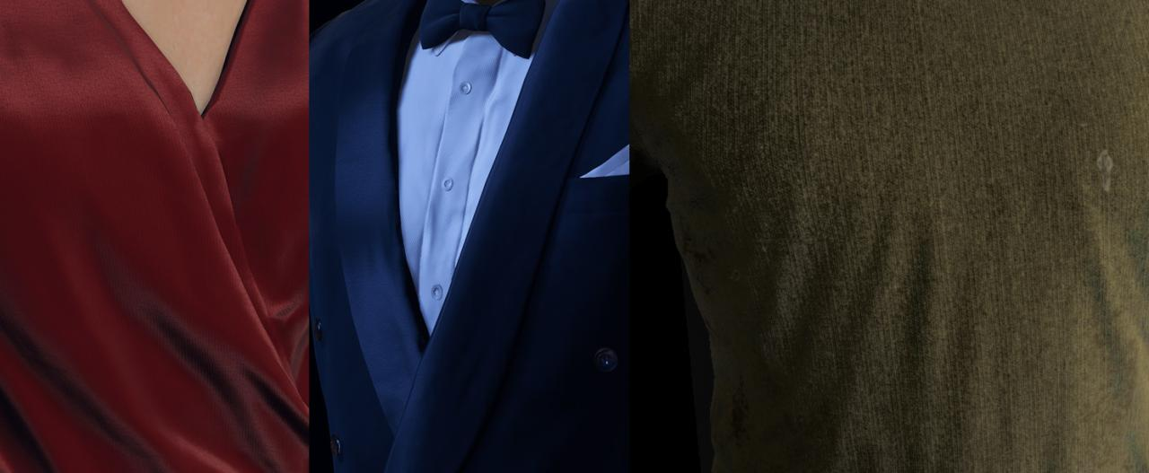
Fabric Reflectance Model

Slide 21
Fabric Reflectance Model
For silk, velvet, and other highly-reflective fabrics
We tested both Anisotropic GGX and Kajiya-Kay. Anisotropic GGX read slightly better, but based on our lighting model, it’s hard to see the advantage in most cases. So we picked the cheaper one.
For cotton, wool, etc.
We used a variation of Ready at Dawn’s cloth reflectance model.
Notes:
The reason that we are using two different reflection models for fabric instead of one, is because we want artist spending less time setting up the shaders.
In this way, for NPC characters. if the artist turned on fabric shader package. They can get pretty good default result to start with.

Slide 22
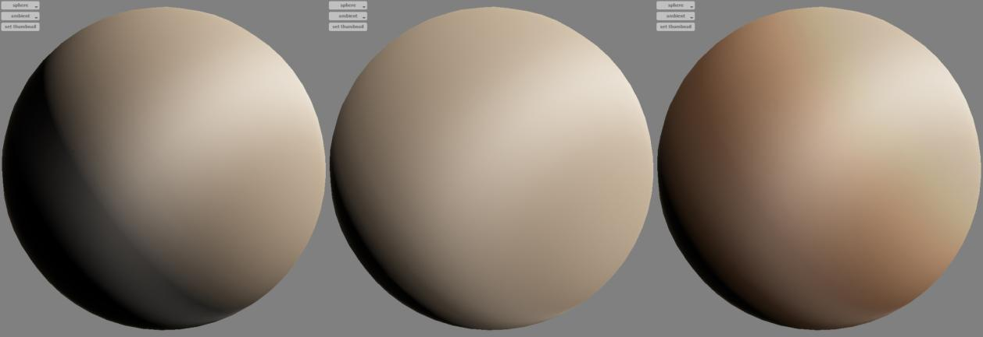
Creating A “Cheap Sub-Surface Scattering” Look
diffuse = saturate(dot(N,L));
finalDiff = baseColor*diffuse*shadow;
diffuse = saturate(dot(N,L)+w)/(1+ w); // 0< w<1
finalDiff = baseColor* diffuse *shadow;
diffuse = saturate(dot(N,L)+w)/(1+ w); // 0< w<1
scatterLight = saturate(scatterColor + saturate(dot(N,L)))*diffuse
finalDiff = baseColor* scatterLight *shadow;

Slide 23
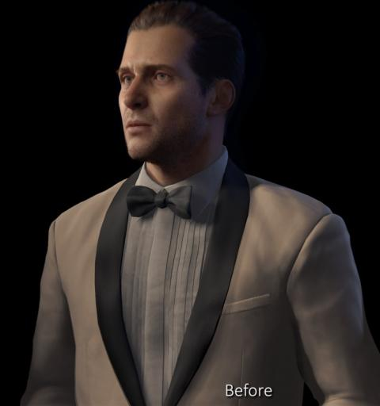
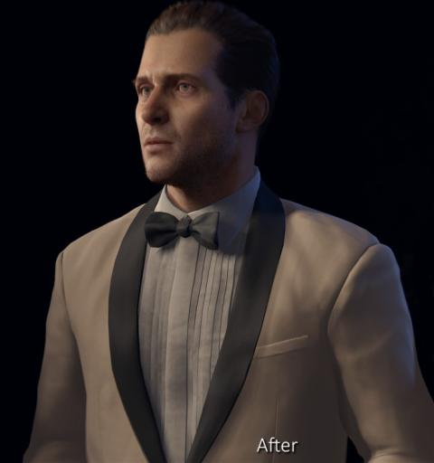
Make the Fabric Look Softer

Slide 24
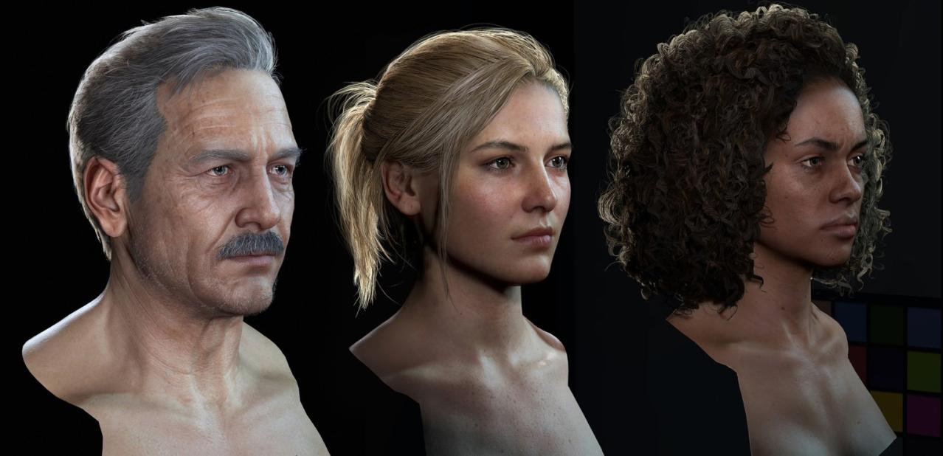
Notes:
Building hair shader library

Slide 25
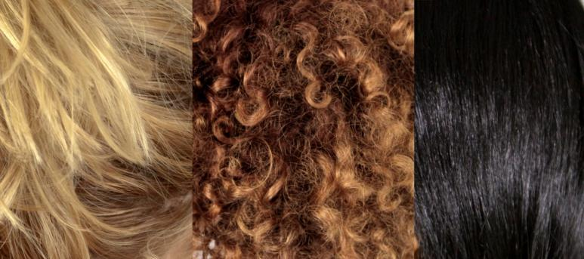
Building Hair Shader Library
Hair strands are really thin; they are also translucent. Each hair strand has a different normal and casts self-shadow between each other. To achieve the volumetric appearance of hair, we need to solve those issues one by one.

Slide 26
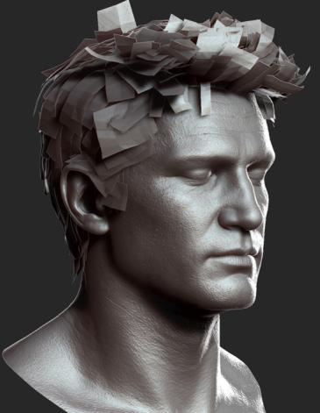
Hair Cards vs. Instanced Geometry Hair
PlayStation 4 had a significant improvement on poly count budget, but it was still hard for us to render out millions of hair strands real-time.
Since we didn’t have much time to go deep into the tessellation shader in this project, we eventually chose hair cards.

Slide 27
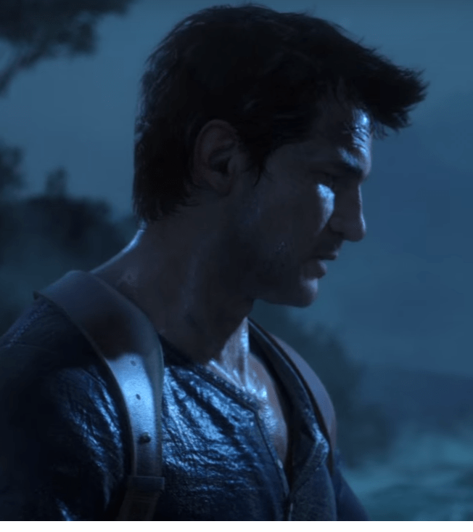
We Ended up Making the Hair Really Expensive
Hi-res transparency maps
Using Alpha blend and Multi-Sample Anti-Aliasing.
Hi-res shadow resolution.
The above got us great results.

Slide 28
But…
Notes:
All these methods cost a lot of GPU. We were unable to sacrifice gameplay and design for the look of the hair. This meant we had to find other ways to deliver similar results.

Slide 29
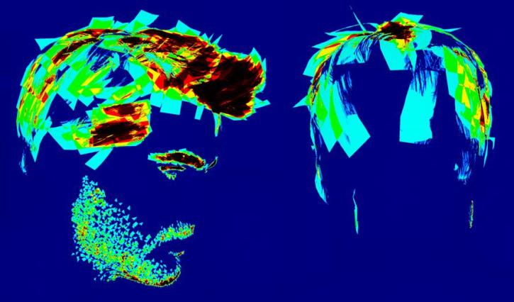
Our Hair Couldn’t Use As Much Alpha-Blending As We Wanted
Here is a screen shot in Debug mode – Texture Overdraw
Notes:
Here Green or Blue means we are ok.
Red means over budget; Darker Red and Black means extremely over budget.
Which means we can’t afford a lot of alpha-blending cards.

Slide 30
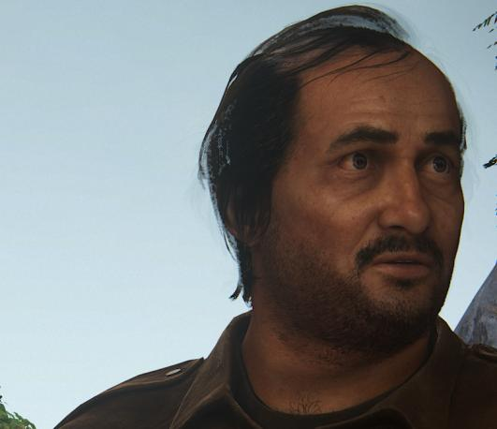
Most of Our Hair Uses Dithered Alpha and Deferred Rendering
For most of our hair, we turned off alpha-blending and use dithered alpha combined with temporal AA. The downside of this method is we got ghost effects when characters were moving too fast or far away from the camera.

Slide 31
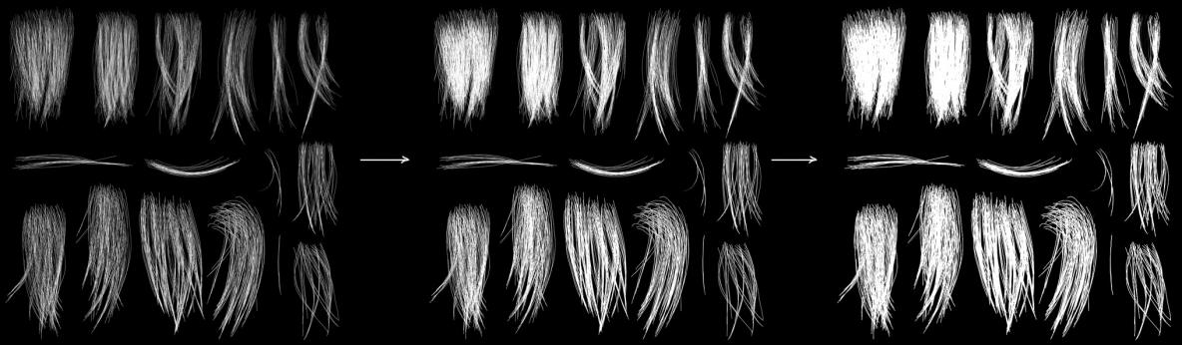
Our Hair Strands Can’t be That Thin
To avoid those issue, we have to adjust value of cutoff threshold. 0<= cutoffThreshold <=1
cutoffThreshold = 1 cutoffThreshold = 0.6 cutoffThreshold = 0.2
Notes:
The idea of cutoff threshold is simple. By adjusting values of our original transparency map. We can make sure our hair are readable when characters are moving or in a distance.

Slide 32
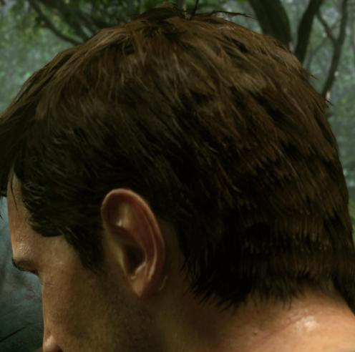
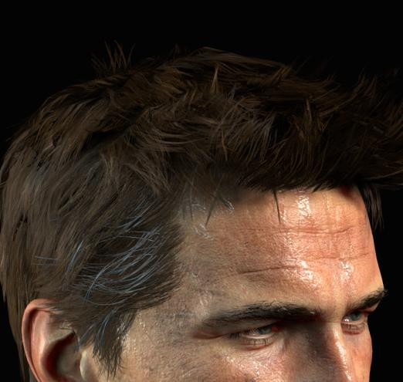
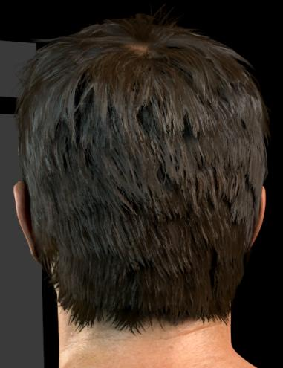
But here is a problem -- They look like “Hair cards”
Notes:
After we reduced the cost of hair shader, they didn’t look appealing to us anymore.
At that time, a lot of artists were discouraged, but eventually, we decided to take the challenge and looking for the reason why our hair did not look good.

Slide 33
Looking for the Reasons
We are using the vertex normal of the cards, instead of the normal from individual hair strands;
Sharp sunlight shadow treats hair cards like opaque objects. But hair strands are translucent;
Notes:
Those issues were already there. But they were not that obvious when we are using high-res alpha-blend.

Slide 34
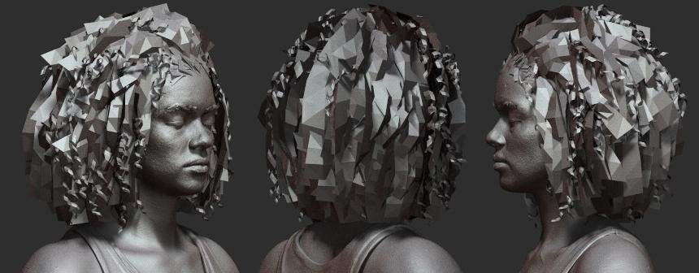
Normal on the Hair
Hair cards were hand-placed by character artists, we use tricks like placing cards intersecting with each other to create a volumetric feeling.
Hair cards of Nadine Ross, modeled by Frank Tzeng

Slide 35
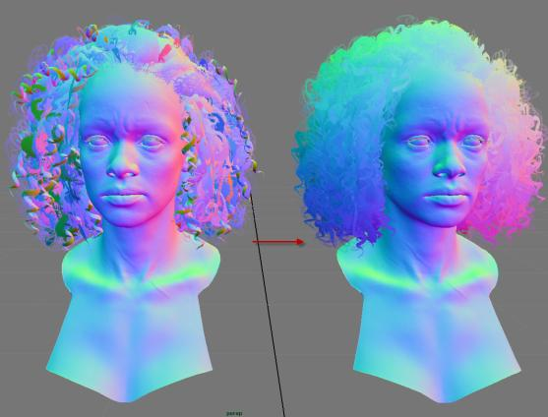
Normal on the hair
To smooth the transition from one card to the other, we need to unify vertex normals on the cards.
Notes:
This step is necessary for the final render. Not only did this make hair overall look like a sphere, but it also fixed the issues of individual cards having disconnection of diffuse, specular and backlighting scatter between cards.

Slide 36
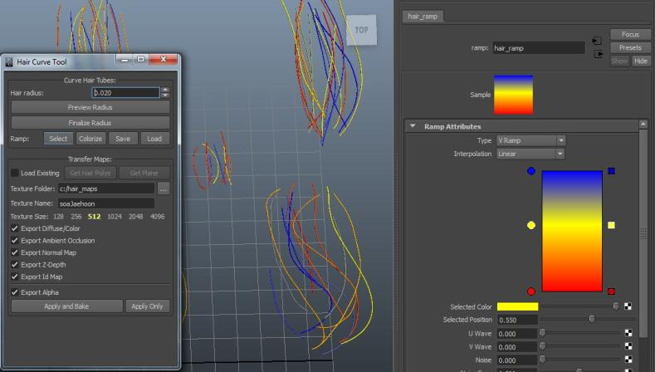
Normal on the Hair
Most of the time, we can’t use high-res normal texture maps.
Notes:
When we were creating hair textures, we baked down variation maps. These break down specular and backlighting scatter to make hair strands stand out.
Character TD Tyler Thornock wrote this hair tool for us

Slide 37
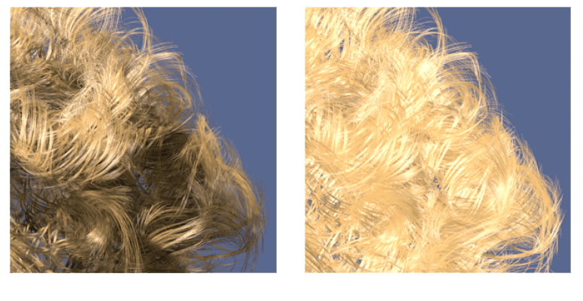
We Need Volumetric Shadows on the Hair
Sharp sunlight shadow treats hair cards like opaque objects. But hair strands are translucent.
Solution:
Reduce the shadow? That will make the hair look flat.

Slide 38
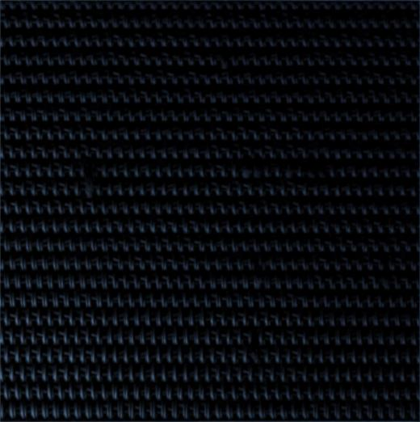
We Experimented with Self-Shadow
Here is a test we did using a precomputed self-shadow that was using 57 lights, which created a broad range of shadow information in different situations.
Notes:
Video of Self-shadow test for fabric details

Slide 39
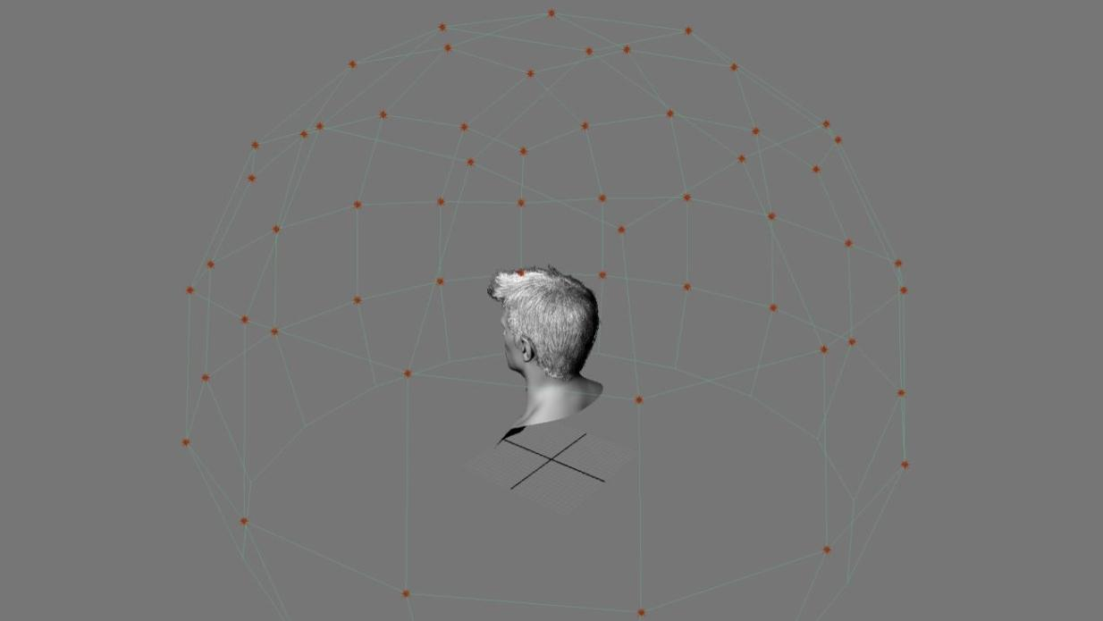
Notes:
We tried the same thing on hair. Since it’s pre-computed, we didn’t need to worry about render time.
We could use semi-transparent alpha maps to bake the shadow information. We got a pretty good result that shows the depth of the hair shadow.

Slide 40
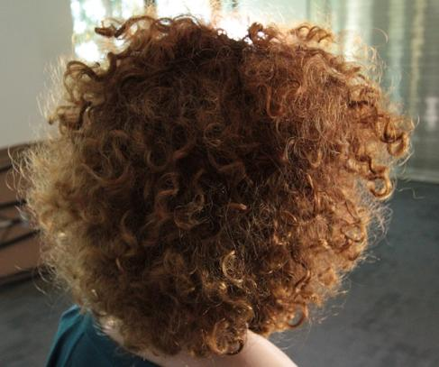
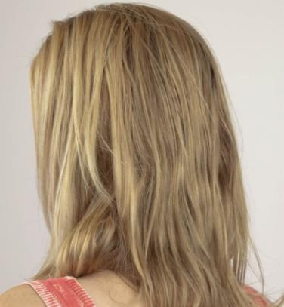
Attempts We Had To Approach Better Precomputed Self-Shadows
We need to find a middle ground to make sure the baked shadows read realistically in most lighting scenes.
We can tell main light direction based on the hair shadow Flat lighting
Notes:
We took references that consider different lighting environments. Based on the reference images, we can tell that sometimes the direction of the lights play an important role for hair shadows, and in some scenes, the lighting situations are quite flat.
We need to find a middle ground to make sure the baked shadows read realistically in most lighting scenes.

Slide 41
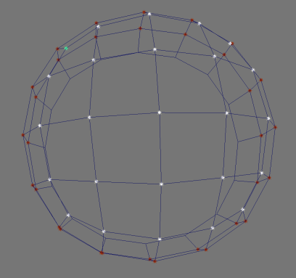

Attempts We Had To Approach Better Precomputed Self-Shadows
We divided all the lights into 5 groups, so that we will running into less issues, when we implement light direction into baked shadows. Also it will make baked shadows information much softer.
Lights from the top Lights from the side
Notes:
In order to achieve that, we divided all the lights into 5 groups.
So that we will running into less issues, when we implement light direction into baked shadows. Also it will make baked shadows information much softer, and make the light direction less readable.

Slide 42
Tight Production Schedule
Notes:
I feel that we were almost there. However, as I mentioned before, with our tight schedule, we couldn’t ship directional pre-computed shadow maps for Uncharted 4.
We will keep on working on it and hopefully we can show you guys something promising next time.

Slide 43

Self-Shadows We Shipped
We ended up combing all the lights together and baking down to one map, with non-directional shadow information.

Slide 44

It Helps Us Get the Feeling of Depth and Volume of the Hair

Slide 45


Getting Hair Details With Limited Texture Memory
+
1k texture for hair details, a lot of hair cards are sharing the same ones
512 X 512 texture for baked shadow map. We are using uvSet2 to store this information.

Slide 46

How Can We Implement It in Game?
We thought about replacing the shadow on the hair entirely with baked shadow maps.
The results look nice in studio light setup, but we need to consider the situation when other objects cast shadows on the hair. There will be issues like “glowing in the dark”.

Slide 47

Combining Baked Self-Shadow with In-Game Shadow
Notes:
If we simply multiply in-game shadow and baked shadow together, we would get really flat looking results.
We can’t ship anything like this.

Slide 48
We Need to Modify Both In-Game and Baked Shadows
Reduce hard in-game shadow on the hair
Simply blurring the in-game shadow on the hair will be too expensive GPU-wise to achieve.
We mentioned before that we made hair thicker in-game to reduce texture overdraw and ghost effect, but we don’t need to thicken it for in-game shadows. Resetting cutoffThreshold is the simplest and cheapest way to reduce in-game shadows.
#ifdef HAS_HAIR
if (passId == kPassShadow)
cutoffThreshold = 1; // 0<= cutoffThreshold <=1
#endif

Slide 49


Reduce In-Game Shadows on the Hair
Before reducing in-game shadows After reducing in-game shadows

Slide 50
Modify Baked Shadow On the Hair
There are a few adjustments towards baked shadow to make the final shadow pass realistic.
Add light wrap on baked shadow
hairShadow = (abs(dot( lightDirWS, normalWS)) + w) / ((1 + w) * (1 + )) // w = 0.5;
Use intensity of the probe lighting and hair color value to control baked shadow
aperture = hairShadow * lerp(0.5,1.0,dot(baseColor, kLuminanceFactor)); //white, blonde hair is getting less shadow
hairShadow = saturate(hairShadow - (1.0 – aperture));

Slide 51


Modify Baked Shadow On The Hair
Before adding baked self-shadow details After adding baked self-shadow details

Slide 52

Scatter on the Hair
Notes:
Scatter on the Hair

Slide 53
Scatter on the Hair
We decided to use a method that gives players an impression of hair scatter, with very low GPU cost.
There are 2 key elements that make hair scatter look realistic:
Scatter in-between hair strands;
Backlit Scatter.
Notes:
In physically based hair shading models, light passes through a hair fiber, and gets Single Reflection (R), Double Transmission (TT), Transmission-Reflection-Transmission (TRT) and so on.
However, instead of diving deeper towards the direction of physically based hair shading models. We decided to use a method that gives players an impression of hair scatter, with very low GPU cost.
So that we can afford it for crowd scene and multiplayer characters.

Slide 54


Scatter In-Between Hair Strands
Similar to “Cheap SSS” on fabric. We found out for most hair color, blond, brunette, black, even white hair, adding reddish color will make hair look more soft and realistic.
diffuse = saturate(dot(N,L));
finalDiff = baseColor * diffuse*shadow;
diffuse = saturate(dot(N,L)+w)/(1+ w); // 0<w<1
scatterLight = saturate(scatterColor + saturate(dot(N,L))) * diffuse
finalDiff = baseColor * scatterLight * shadow;
// For our hair, scatterColor = lerp(float3(0.992, 0.808, 0.518),baseColor,0.5);

Slide 55


Backlit Scatter
In this approach, we consider hair as a sphere. We can see the scatter look based on light, camera angles and surface normal.
The scatter amount varies based on hair color, hair shape, hair length and light intensity.
Backlighting reference image

Slide 56

Backlit Scatter
Code:
----------------------------------------------------------------------------------
scatterFresnel = pow(cosThetaV , scatterPower);
scatterLight = pow(saturate(dot(V,-L)), scatterPower) *
(1.0 - cosThetaV) * (1.0 - cosThetaL);
transAmount = scatterFresnel + lightScale * scatterLight;
----------------------------------------------------------------------
scatterPower is a power value we adjust to make the scatterFresnel shape look believable.
In our case, scatterPower = 11 for short hair, scatterPower = 9 for long and puffy hair.
lightScale is a value we choose based on the scatter value of the hair. For most blond hair, we choose a higher value.

Slide 57


Adding Variation on Backlit Scatter
As mentioned before, we have to make the hair strands thicker, reducing sorting issue and texture overdraw. In the mean time, adding variation on scatter will make the hair strands stand out with really low cost.
Notes:
Variation maps used to break down the scatter and specular for hair strand details

Slide 58

Hair Reflectance Model
Kajiya-Kay
There is nothing new on the basic hair reflectance model;
2. Specular variation.
We are mostly sharing one variation mask on all the hair materials.
Reasons:
Specular variation will only give the players a feeling of hair strands;
Errors are not as obvious as other variation masks;
Our hair card UV layouts are unified.
Specular variation mask
Notes:
We are using a tile-able noise pattern to breakdown the specular variation instead of high-res texture maps

Slide 59


Reduce the Texture Memory for NPCs and Multiplayer Characters
Main Character Nadine’s Hair Multiplayer Nadine’s Hair
Notes:
As we know that Scatter and Specular variations are really important for the hair final look.
We tested by using the same tile-able noise as variation mask texture, which doesn’t 100% match the hair flow. We realized that actually errors are not that obvious to spot. It’s good enough for NPCs and multiplayer characters.

Slide 60

What is a Shader Package ?
Notes:
At last we are going to talk about shader package, which have been widely used in our character shading pipeline.

Slide 61

Notes:
Video of snow shader in dynamic wear and tear package

Slide 62


What is a Shader Package?
A shader package is a black box that is created by a shader artist. By using a few inputs from the users, it can achieve consistent high quality render results without requiring users to study complicated shader rules or doing repeated work that can be done automatically.
Inputs:
results:
Black Box
Notes:
It was inspired by the shading pipeline of animation feature film. In film production, shading artists were doing research of different surface materials and building the packages before crunch started.
Once the artist created a package, other artists could easily get the materials they wanted by adjusting a few sliders.
Also, during production, shading artists could get feedback from other artists and update the packages. All the materials that are using the package will be updated too.

Slide 63


Traditional Static Shader Library vs. Shader Package
Static shader library
It's easier to contribute to the library
Relatively cheaper, if all the maps were baked down
Shader Package
Easy to use, easy to update
Speed up production during crunch
Constancy of the quality of the materials
Easy to add special features for certain materials
Quickly spot issues when lighting model changed

Slide 64

Examples of Other Shader Packages
Fur materials

Slide 65

Examples of Other Shader Packages
Skin materials

Slide 66

Examples of Other Shader Packages
Eyes

Slide 67

Lessons We Learned
Notes:
The most valuable lesson we learned was - Shipping a game was way different than making a real-time demo. Gameplay and having smooth framerates are always the number one priority. There are so many things in our game could slow down the frame rates, such as crowds, particles, complex environments, etc.
We had to cut down the cost of characters constantly, instead of mainly focusing on pretty images. There were so many times we almost lost hope about whether we were able to ship something decent with such strict limitations. Fortunately, we have a great team with all kind of creative ideas and always there to help each other. It’s a great honor to be part of the team, and it’s a great learning experiences to work on this challenging project.

Slide 68
Special Thanks
Character Team:
Frank Tzeng, Colin Thomas, Soa Lee, Jaehoon Kim, Byung Hwa Jung, Adam Scott,
Adam Skutt, Corey Johnson, Glauco Longhi, Nicolas Collings, Wasim Khan, Tyler Thornock,
Hans Godard, Nathan Horne, Damon Shelton, Nancy Cantu, Erik Ortiz
Others:
Vincent Marxen, Waylon Brinck, Ramy El-Garawany, Ke Xu, Carlos Gonzalez-Ochoa
Andrew Maximov, Tate Mosesian, Dave Smith, Jerome Durand, Edward Pereira,
Mark Shoaf, Leandro Amaral, Nicholas Lance, Connie Huang, Inigo Quilez,
Jorge Jiménez, Natalya Tatarchuk

Slide 69
We are hiring
http://www.naughtydog.com/work

Slide 70
Questions?

